Slide 1


Visualizing DeFi: The Evolution of a Connected Ecosystem
defi.wtf
October 7, 2019
Christian Crowley
Christian.Crowley@consensys.net
CEO | Aleth.io

Slide 2


The evolution of defi
Notes:
In 2017
>700 ICO’s raised over $4.7 B
As of September 2018...
>100k new daily users (350k new accounts created on 1/4 - a platform record!)
>1,500 DApps live or in development
>35M unique addresses on Ethereum

Slide 3
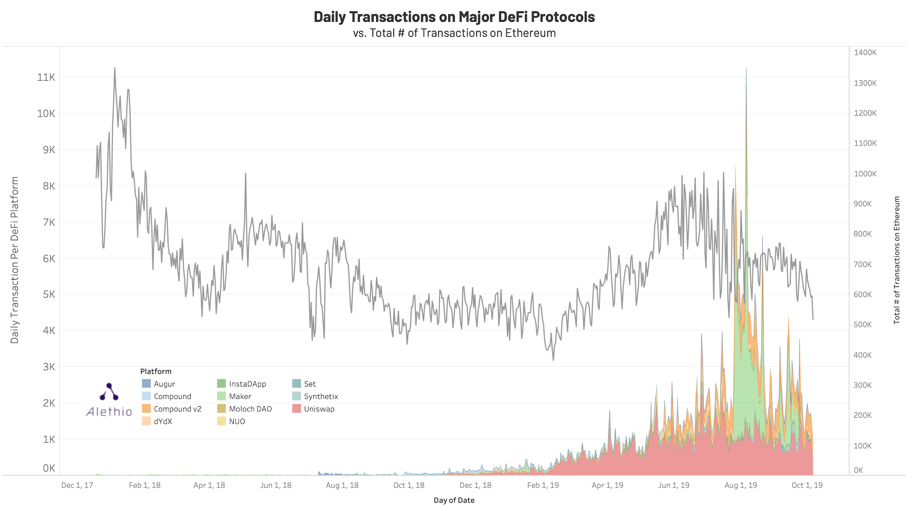

Slide 4
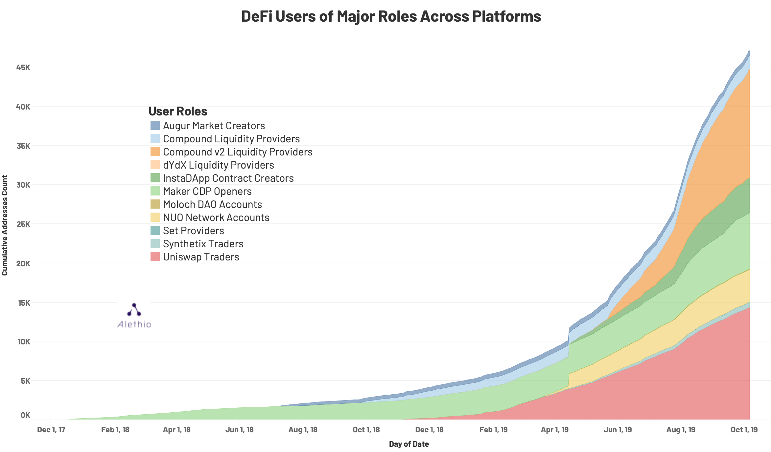

Slide 5

The Evolution of DeFi: Dec 2017 - Oct 2019

Slide 6
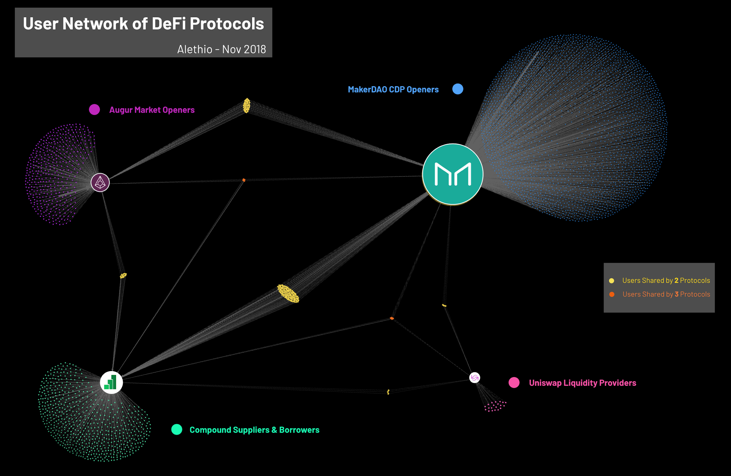

Slide 7
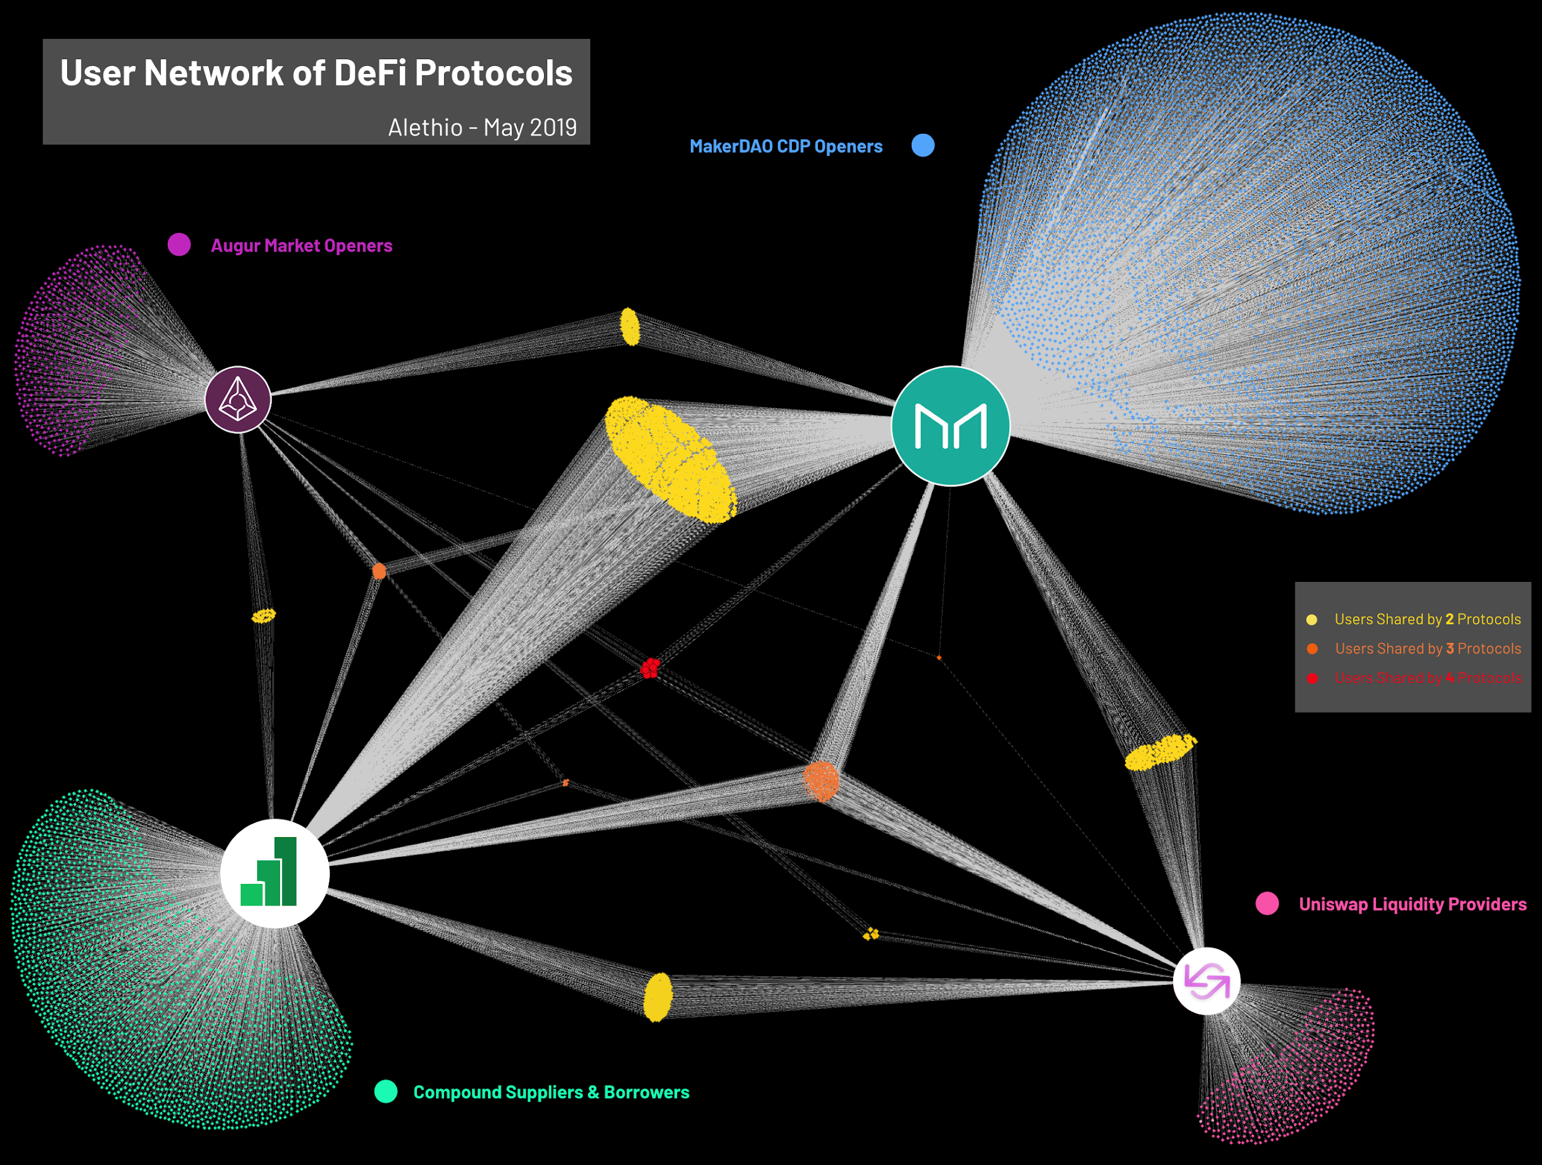

Slide 8
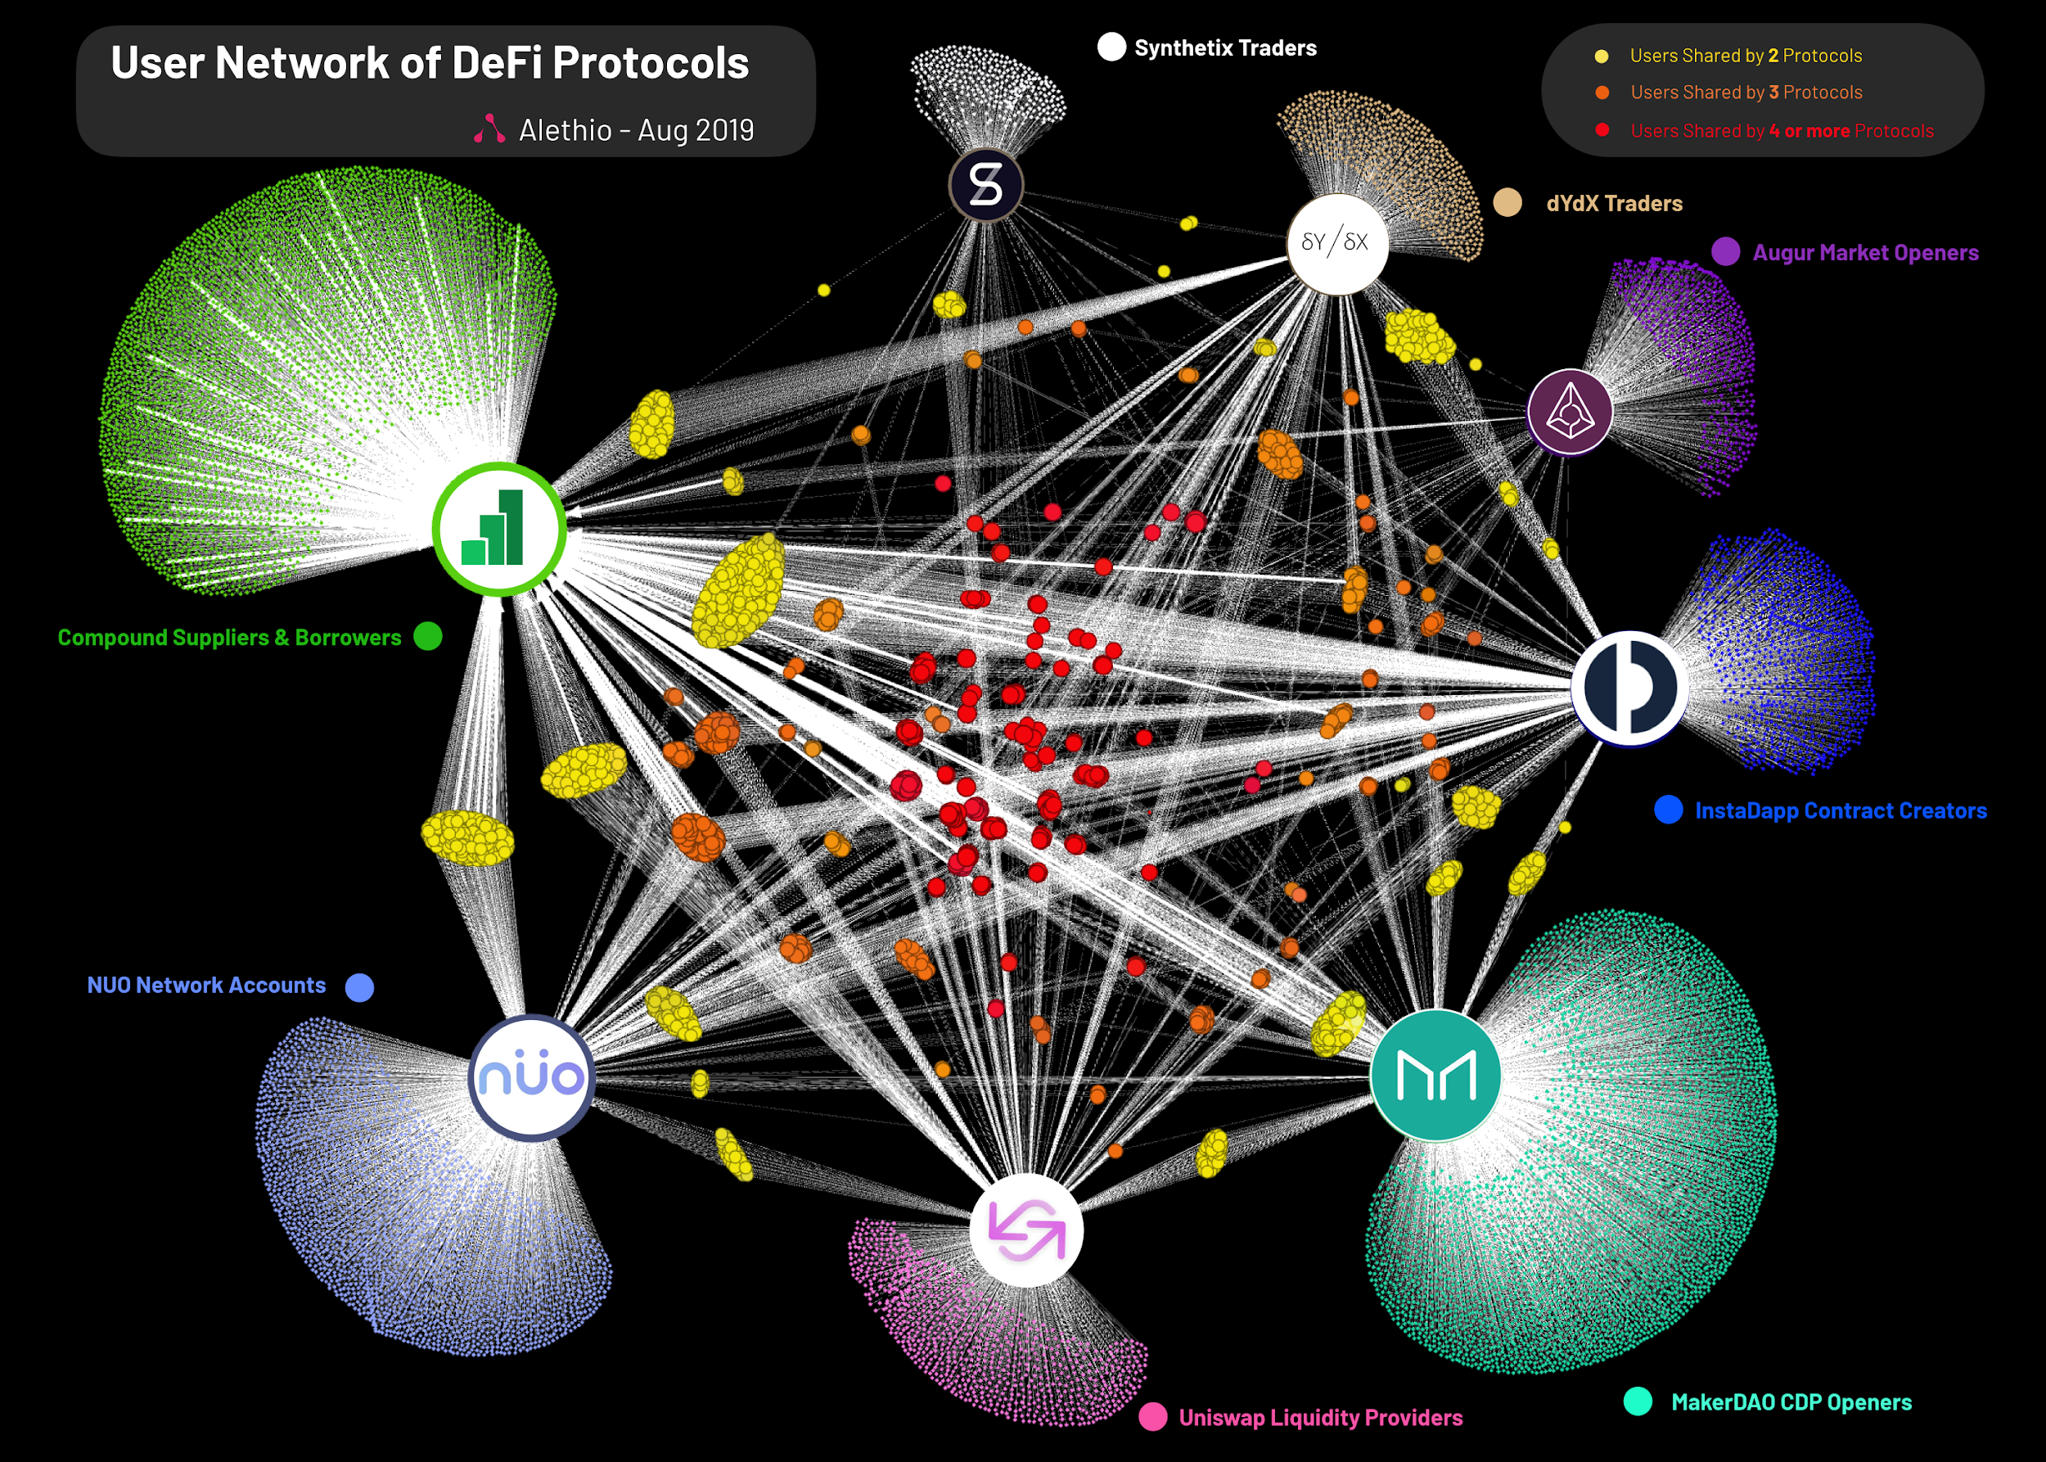
Notes:
Financial behaviors
Graph are informative & exploratory

Slide 9
DeFi & DEX: blurring lines
Notes:
In 2017
>700 ICO’s raised over $4.7 B
As of September 2018...
>100k new daily users (350k new accounts created on 1/4 - a platform record!)
>1,500 DApps live or in development
>35M unique addresses on Ethereum

Slide 10
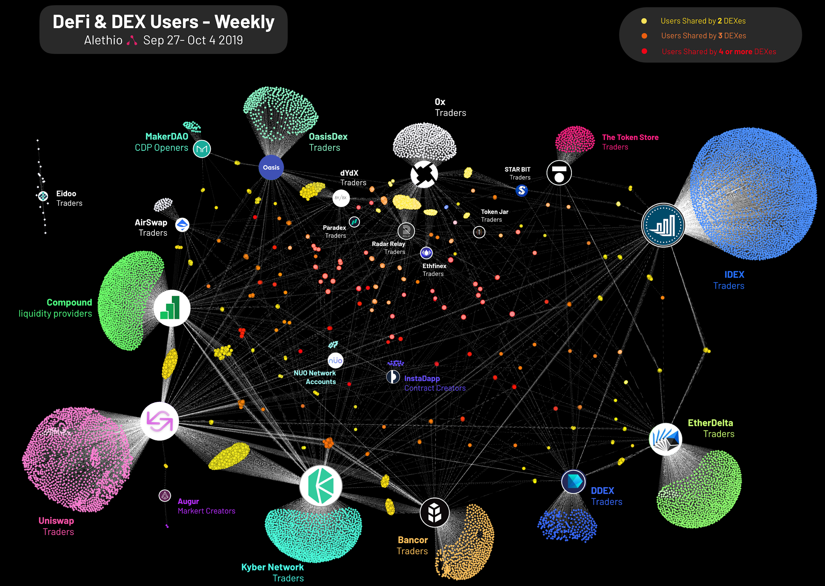

Slide 11
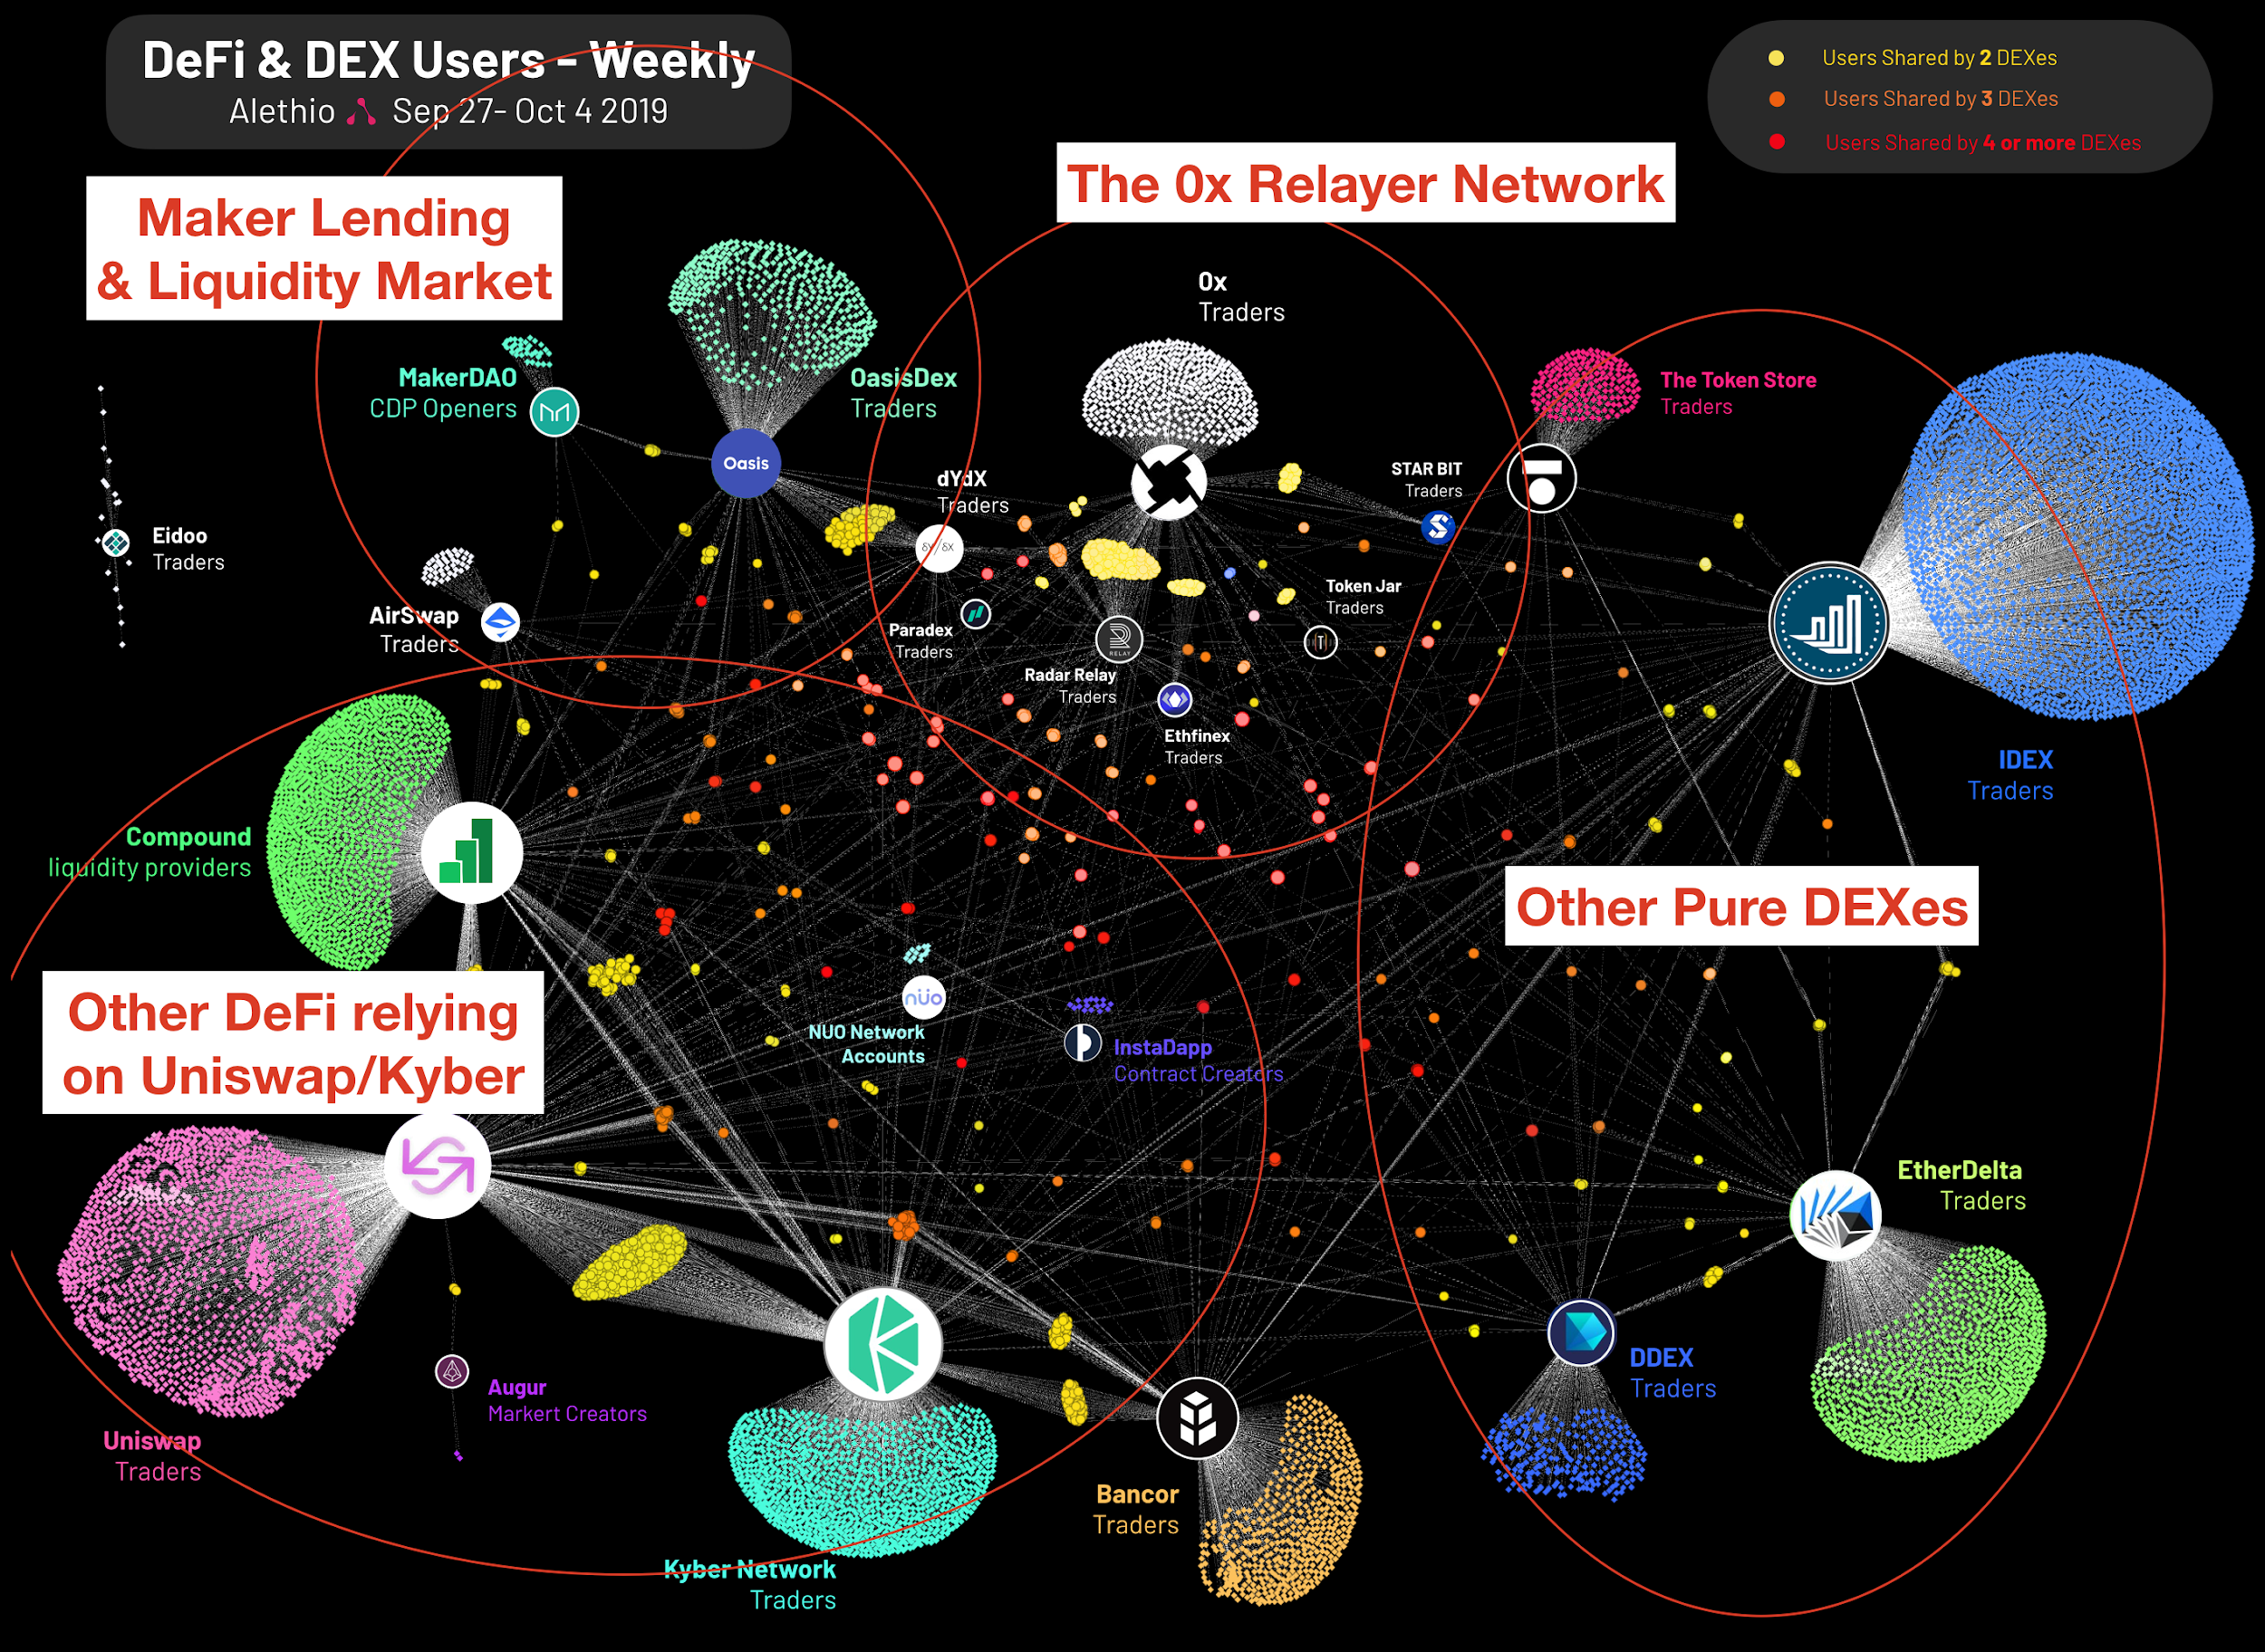

Slide 12
Appendix
Notes:
In 2017
>700 ICO’s raised over $4.7 B
As of September 2018...
>100k new daily users (350k new accounts created on 1/4 - a platform record!)
>1,500 DApps live or in development
>35M unique addresses on Ethereum

Slide 13
Case Study
Decentralized Finance | User Base of DEX & DeFi
Visualization: Co-currency Matrix Heatmap
How many of their users are overlapped?
How’s the user loyalty across different platform?
What would be potential user adoption direction?
Notes:
Here is a innovative visual we created for lots of the DEX customers who’d like to know better about their users, a

Slide 14
Case Study
Decentralized Finance | User Base of DEX & DeFi
Graph Algorithm : PageRank & Connected Component
What are the most influential nodes across transaction network?
Network Graph Visualization
How are financial products connected through users?
What are the major financial behaviors of users on blockchain?

Slide 17
Notes:
Financial behaviors
Graph are informative & exploratory

Slide 18
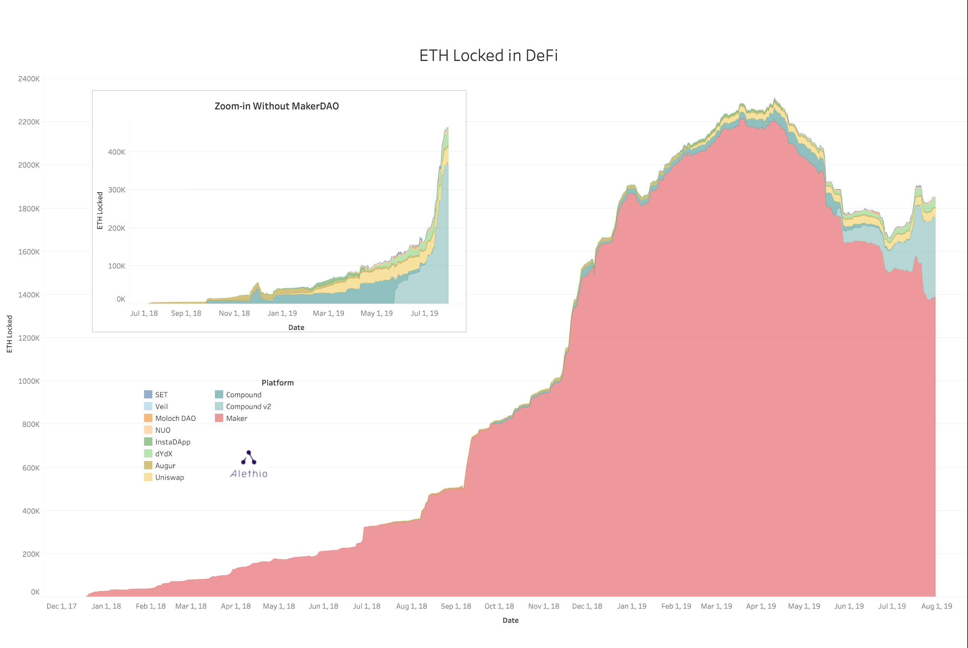
ETH Locked in DeFi
defi.aleth.io
The State of Ethereum & Information Asymmetry
The Rise of Decentralized Finance (DeFi)
The Alethio Platform

Slide 19
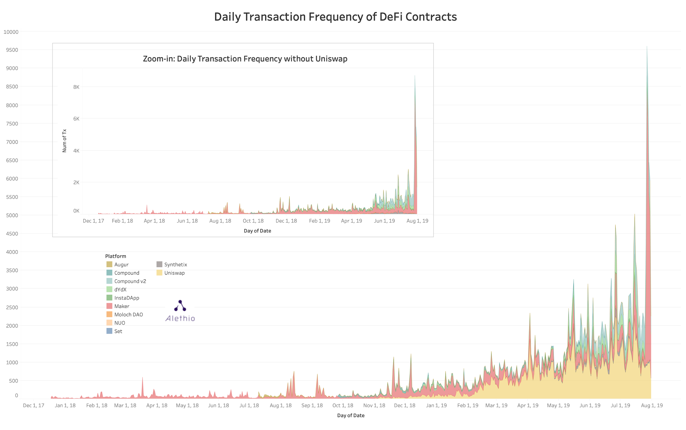
Daily Transaction Frequency of DeFi Contracts
defi.aleth.io

Slide 20
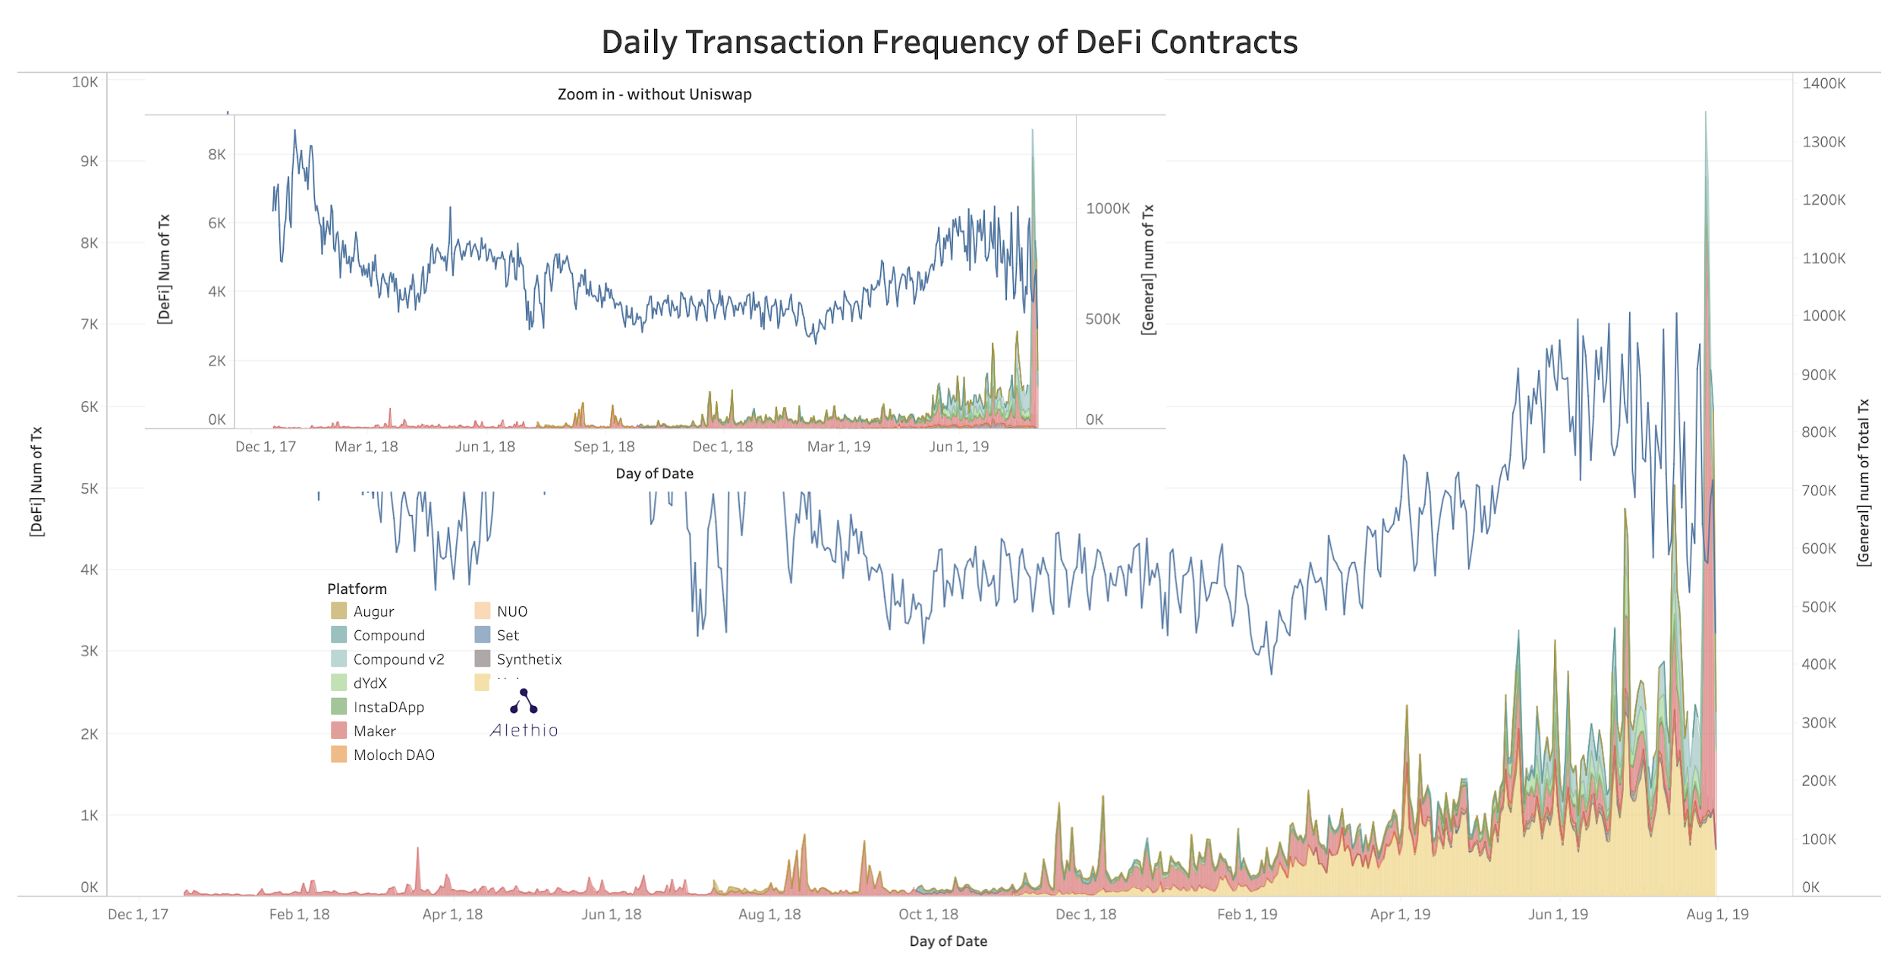
Daily Transaction Frequency of DeFi Contracts vs. Overall Tx on Ethereum
defi.aleth.io

Slide 21
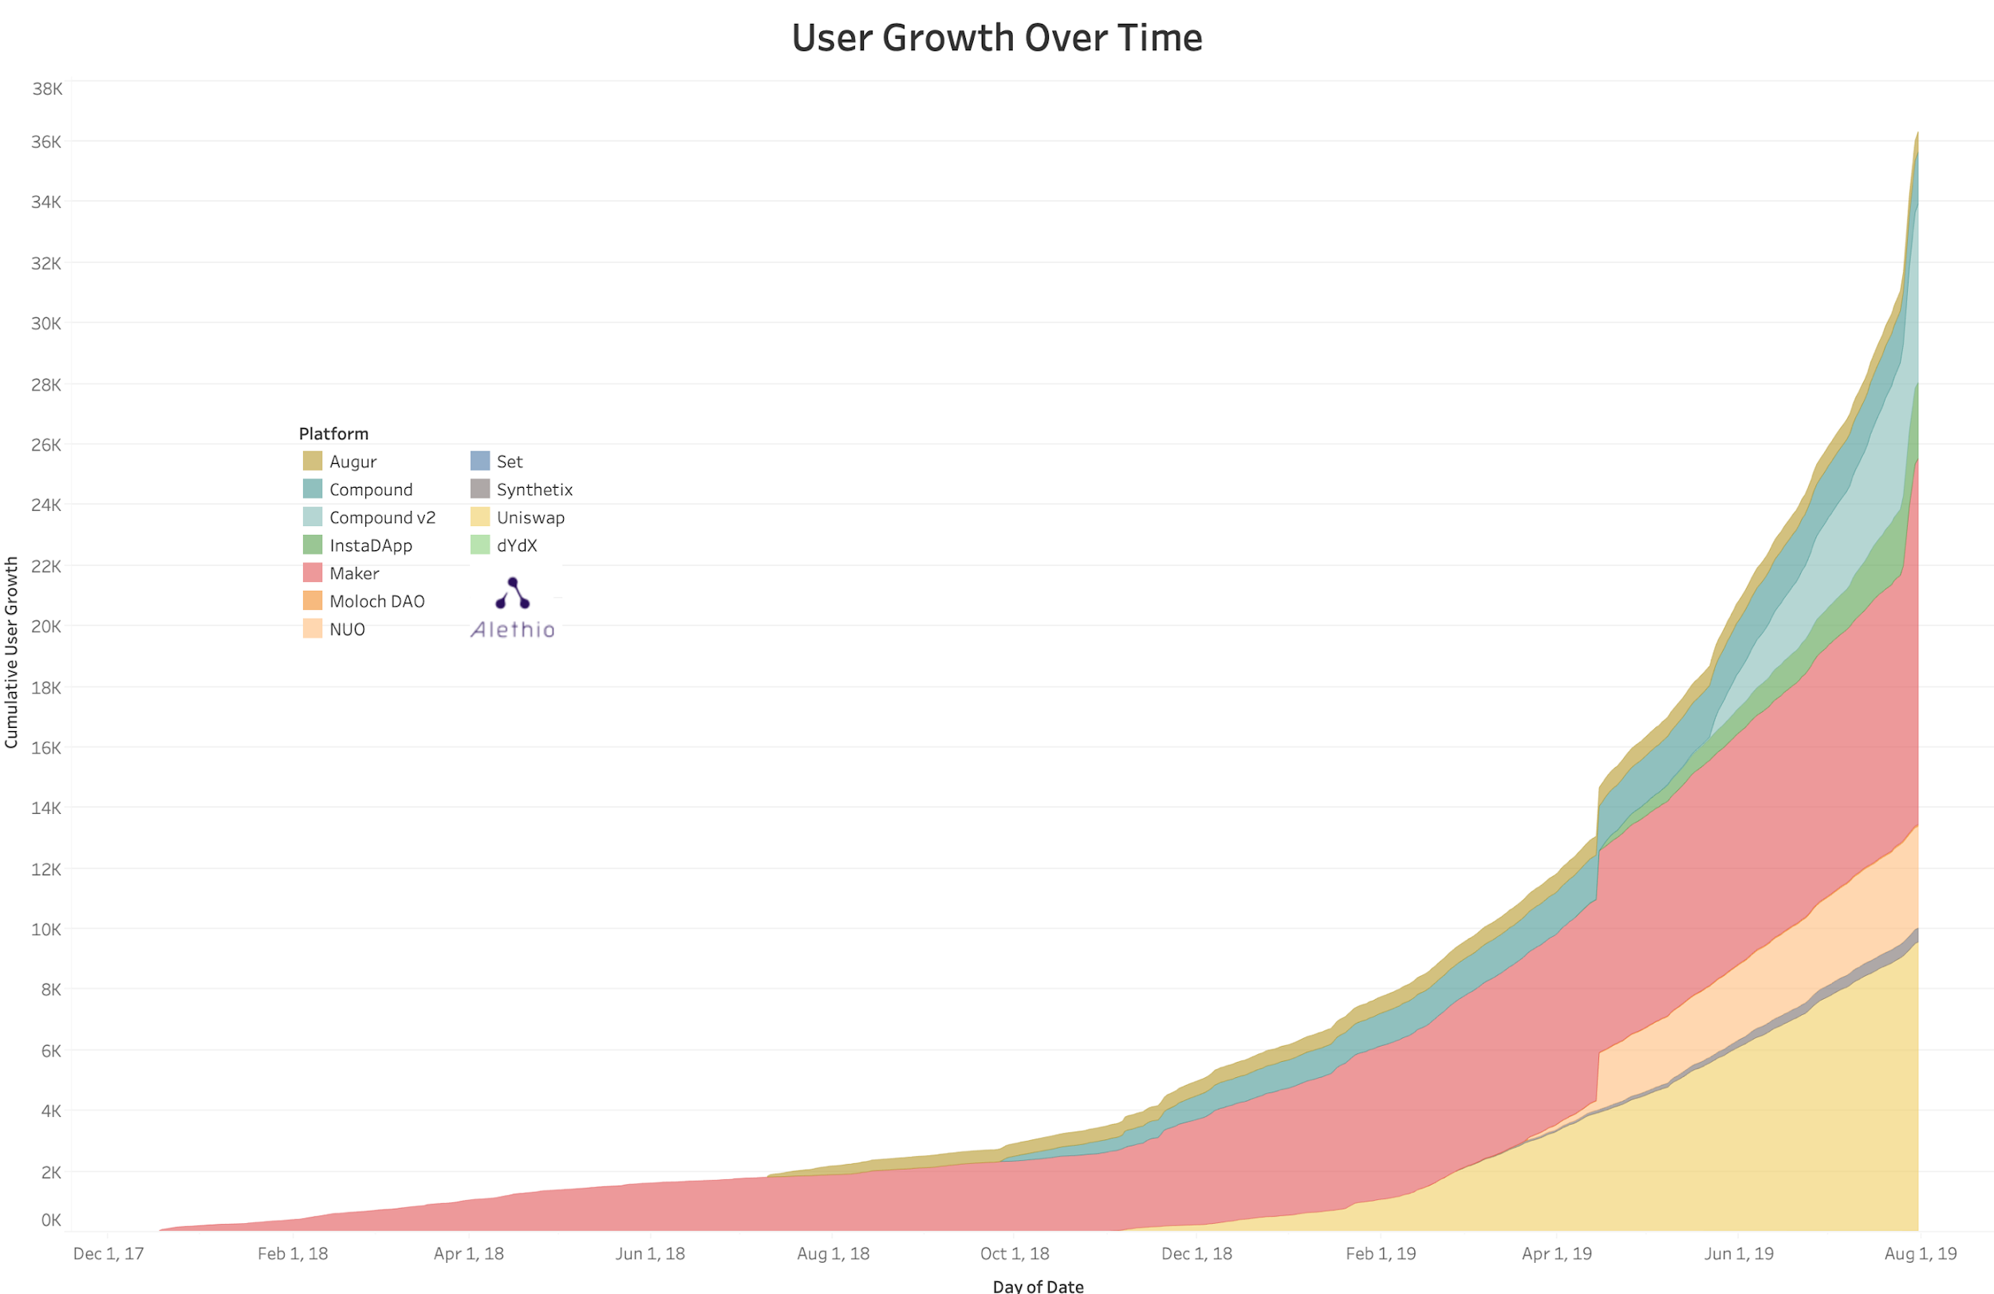
DeFi User Growth Over Time
defi.aleth.io
Show gifs of products

Slide 22
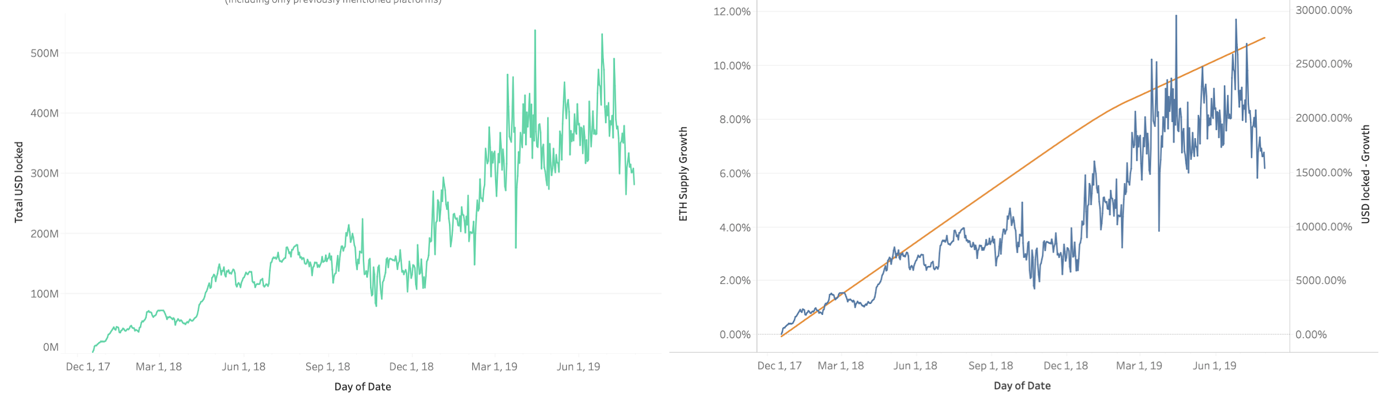
DeFi rising
defi.aleth.io
USD locked in DeFi Platforms (since Dec 2017)
(Including only previously mentioned platforms)
Cumulative % Growth in DeFi vs ETH Supply
(since Dec 2017)

Slide 23
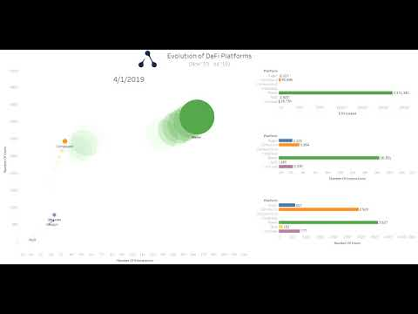
Evolution of DeFi Platforms
defi.aleth.io

Slide 24




Thank you!
aleth.io
ethstats.io
Dex.Watch
partnerships@aleth.io
Christian Crowley
CEO | Alethio
@AlethioEthstats
@ChrisCCrowley
Notes:
We don’t have time left for questions, but happy to take them afterwards.

